Slide 1

KultureHire
Data Analytics
Internship
Understanding of Career Aspirations of Gen Z
Chiranjib Mondal

Slide 2
ROADMAP
Problem Statement
Data Collection
Data Cleaning & Standardisation
Exploratory Data Analysis
Presentation
Functional Dashboard in PowerBI
Executive Dashboard in Excel
Analyzing in SQL

Slide 3
STAGE 1:
PROBLEM STATEMENT

Slide 4
Who is affected?
What is happening?
College graduates, those with 0–3 years of work experience, and recent job seekers. Primarily individuals aged 18–24 (born between 1997–2012).
College graduates with degrees in humanities, social sciences, business, and STEM fields. Predominantly in urban areas but also growing in rural and suburban locations. Seeking roles in tech, creative industries, sustainability-focused organizations, and companies with strong social values.
Tech, retail, hospitality, healthcare, and financial services.
Growing challenges in companies that are traditionally hierarchical or offer rigid job structures.
Business Type: Includes large corporations, mid-sized businesses, and startups.
Leadership/Management: Companies with outdated management structures, top-down hierarchies, or a lack of flexibility in work practices (remote work, flexible hours, etc.) face more significant challenges.
Primary Responsibility: HR professionals, career coaches, recruitment agencies, and individual employees.
Support Systems: Educational institutions, career counselling centres, mentors, and leadership teams.
Key Stakeholders: Educational Institutions: Provide career counselling and alignment of curricula with market needs.
Corporations: Adapt recruitment and retention strategies.
Recruitment Agencies: Facilitate better job matching and understanding of Gen Z expectations.
Mentorship Programs: Offer guidance in navigating career aspirations.
Government Agencies: Assist with employment policies, job training programs, and internships.
Mismatch between academic qualifications and available jobs.
Lack of job roles that combine both passion and career growth potential.
Insufficient career guidance and networking opportunities during education.
Struggles with creating a culture that aligns with Gen Z’s preference for inclusivity, transparency, and flexibility.
Gen Z’s desire for fair compensation, job stability, and competitive salaries.
Strong demand for work-life balance, remote work options, and flexible schedules.
Challenges in offering roles that align with Gen Z's values around sustainability, ethics, and corporate social responsibility.
Gen Z seeks roles with clear career progression and learning opportunities.
Desire for work that aligns with their personal values and contributes to society.
Preference for flexible working hours, remote work, and autonomy in their roles.
Lack of growth opportunities, insufficient mentorship, or leadership development.
Lack of effective communication, micromanagement, or disconnected leadership.
Feeling disconnected from the company's mission or values, leading to a lack of engagement.
Workplace culture that doesn't foster inclusivity, diversity, and purpose driven work can create friction with Gen Z.
Gen Z places high value on organizations that are actively involved in social issues like environmental sustainability and equity.

Slide 5
When is this happening?
Where is this happening?
This problem became more apparent as Gen Z entered the workforce in significant numbers (post-2020).
The impact of the COVID-19 pandemic, remote work, and shifting societal values exacerbated this gap.
Typically noticed during recruitment when traditional methods (job boards, in-person interviews) yield fewer results.
Employers also recognize it post-onboarding when turnover rates spike or when engagement metrics decrease.
Early in their careers (0–2 years) when they realize the job doesn’t align with their values.
During career transitions (e.g., switching jobs or industries), when expectations are not met.
After 2–3 years in a role, if there is no visible growth or progression.
Employers should adapt their strategies to align with the values and expectations of Gen Z before the hiring process.
Regular check-ins and career development initiatives should be implemented early on to retain Gen Z employees.
LinkedIn, Glassdoor, Indeed, AngelList (for startups).
Specific job fairs, networking events, and social media platforms like TikTok and Instagram (influencers, creators, startups).
Urban areas, especially tech hubs like San Francisco, New York, London, or Berlin.
Increasing interest in remote or hybrid work, with less focus on geographic location.
A lack of structured onboarding programs, mentorship, and clear role expectations.
Difficulty in providing feedback in a way that resonates with Gen Z's communication style (frequent, direct, and transparent).
Employers struggle with providing long-term growth paths or opportunities for continuous learning.
In roles within more traditional or hierarchical industries like finance or manufacturing, where flexibility, innovation, and values alignment may be lacking.
Entry-level positions that don't offer career growth or don't align with personal values.
Employers fail to clearly communicate role expectations, career growth opportunities, and company culture.
Gen Z employees often feel that the reality of the role doesn’t match what was promised during recruitment.
Lack of transparency or regular feedback mechanisms leads to misalignment in expectations.

Slide 6
Why is that happening?
How to solve it?
Limited job opportunities that align with their educational background and personal values.
Structural constraints in many industries (e.g., traditional office-based roles, rigid hierarchical job structures).
Gen Z has many options, including gig economy roles, freelancing, and entrepreneurial ventures.
Many employers fail to align their culture with the values that Gen Z holds (e.g., sustainability, work-life balance, diversity).
Raised in the digital age, Gen Z values immediacy, flexibility, and work that is aligned with their values.
Economic factors like rising student debt, the gig economy, and the collapse of traditional career ladders have shaped their expectations.
Generational disconnect between management and younger employees.
Slow adaptation to digital tools, flexible work models, and inclusivity practices.
Lack of career growth opportunities.
Desire for more meaning in work and the ability to contribute to causes they care about.
Participate in mentorship programs and career counselling.
Engage in internships, apprenticeships, and skill-building workshops to better understand market needs.
Actively build a professional network to access opportunities in desired industries.
Implement digital-first recruitment (social media, job platforms, virtual fairs).
Offer flexible work options (remote, hybrid, flexible hours).
Align brand messaging with Gen Z values (sustainability, diversity, and inclusivity).
Offer purpose-driven roles that align with Gen Z’s personal values.
Career development opportunities through mentorship, continuous learning, and growth potential.
Implement regular feedback loops and recognition programs.
Introduce personalized coaching and clear role definitions.
Offer continuous learning opportunities and the possibility for flexible working arrangements.
Create a culture of open communication, transparency, and empathy in leadership.
Frequent feedback cycles, clear role definitions, and career progression check-ins.
Foster ongoing conversations around work expectations, culture, and values from the moment of recruitment through to performance reviews.

Slide 7
Why is that happening?
How to solve it?
Limited job opportunities that align with their educational background and personal values.
Structural constraints in many industries (e.g., traditional office-based roles, rigid hierarchical job structures).
Gen Z has many options, including gig economy roles, freelancing, and entrepreneurial ventures.
Many employers fail to align their culture with the values that Gen Z holds (e.g., sustainability, work-life balance, diversity).
Raised in the digital age, Gen Z values immediacy, flexibility, and work that is aligned with their values.
Economic factors like rising student debt, the gig economy, and the collapse of traditional career ladders have shaped their expectations.
Generational disconnect between management and younger employees.
Slow adaptation to digital tools, flexible work models, and inclusivity practices.
Lack of career growth opportunities.
Desire for more meaning in work and the ability to contribute to causes they care about.
Participate in mentorship programs and career counselling.
Engage in internships, apprenticeships, and skill-building workshops to better understand market needs.
Actively build a professional network to access opportunities in desired industries.
Implement digital-first recruitment (social media, job platforms, virtual fairs).
Offer flexible work options (remote, hybrid, flexible hours).
Align brand messaging with Gen Z values (sustainability, diversity, and inclusivity).
Offer purpose-driven roles that align with Gen Z’s personal values.
Career development opportunities through mentorship, continuous learning, and growth potential.
Implement regular feedback loops and recognition programs.
Introduce personalized coaching and clear role definitions.
Offer continuous learning opportunities and the possibility for flexible working arrangements.
Create a culture of open communication, transparency, and empathy in leadership.
Frequent feedback cycles, clear role definitions, and career progression check-ins.
Foster ongoing conversations around work expectations, culture, and values from the moment of recruitment through to performance reviews.

Slide 8
STAGE 2:
DATA COLLECTION

Slide 9
What is your preferred mode of learning?
⭘ Online Courses
⭘ Classroom Sessions
⭘ Workshops & Bootcamps
⭘ Self-Study
How often do you use social media for learning and networking?
⭘ Daily
⭘ Weekly
⭘ Monthly
⭘ Rarely
What is the biggest challenge you face in skill development?
⭘ Lack of time
⭘ High course fees
⭘ Limited resources
⭘ Lack of motivation
Which industry interests you the most for a future career?
⭘ Technology & IT
⭘ Marketing & Sales
⭘ Finance & Consulting
⭘ Creative & Media
How likely are you to participate in online internships?
⭘ Very likely
⭘ Somewhat likely
⭘ Neutral
⭘ Not likely
What type of work environment do you prefer?
⭘ Remote
⭘ Hybrid
⭘ On-site
⭘ No preference
Which skill do you think is most important for career success?
⭘ Technical skills
⭘ Communication skills
⭘ Leadership skills
⭘ Problem-solving skills
How do you prefer to receive feedback on your work?
⭘ One-on-one meetings
⭘ Email or written reports
⭘ Peer reviews
⭘ No preference
What factor influences your job selection the most?
⭘ Salary & benefits
⭘ Company culture
⭘ Career growth opportunities
⭘ Work-life balance
How confident are you about securing a job after your internship?
⭘ Very confident
⭘ Somewhat confident
⭘ Neutral
⭘ Not confident

Slide 10
STAGE 3:
DATA CLEANING & STANDARDISATION

Slide 11
What are the top 5 influences on career aspirations?
Top 5 preferred company types.
Gen Z who wanted to pursue a Higher Education.
Top 3 work setup.
Alignment of company mission and actions.
Clarity of company mission (percentage).
Distribution of minimum expected salary for the first three years.
Most common work frustrations.
Slicer as Gender.
KPI - Total Respondents.

Slide 12
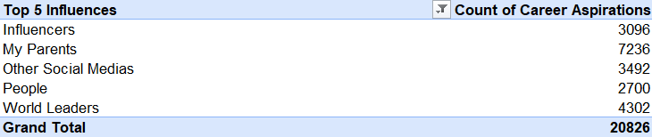
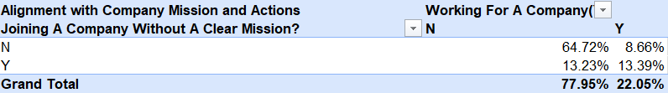
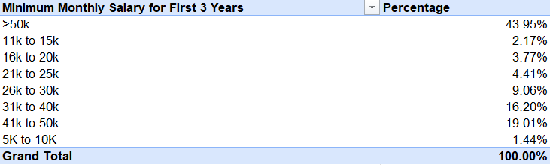
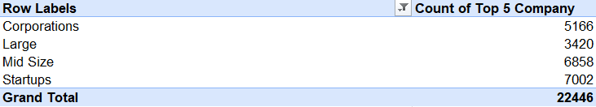
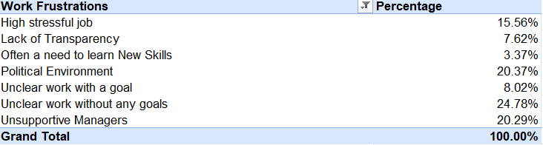
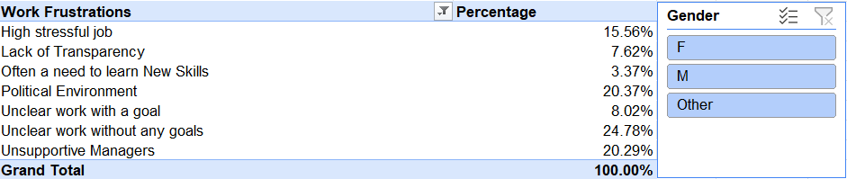
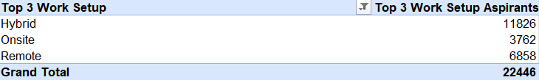
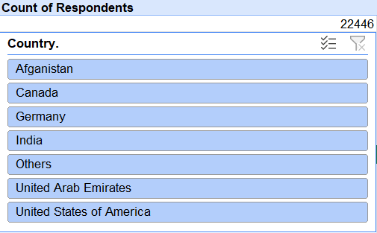
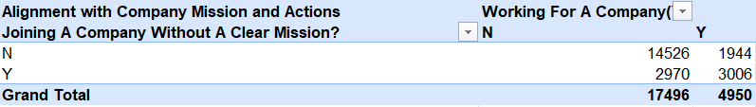

Slide 13
STAGE 4:
EXPLORATORY DATA ANALYSIS

Slide 14
What is the gender distribution of respondents from India?
What percentage of respondents from India are interested in education abroad and sponsorship?
What are the 6 top influences on career aspirations for respondents in India?
How do career aspiration influences vary by gender in India?
What percentage of respondents are willing to work for a company for at least 3 years?
How many respondents prefer to work for socially impactful companies?
How does the preference for socially impactful companies vary by gender?
What is the distribution of minimum expected salary in the first three years among respondents?
What is the expected minimum monthly salary in hand?
What percentage of respondents prefer remote working?
What is the preferred number of daily work hours?
What are the common work frustrations among respondents?
How does the need for work-life balance interventions vary by gender?
How many respondents are willing to work under an abusive manager?
What is the distribution of minimum expected salary after five years?
What are the remote working preferences by gender?
What are the top work frustrations for each gender?
What factors boost work happiness and productivity for respondents?
What percentage of respondents need sponsorship for education abroad?

Slide 15
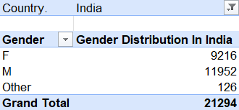
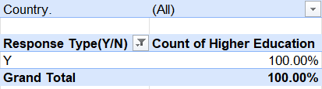
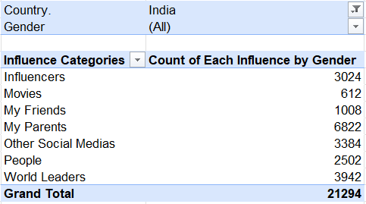
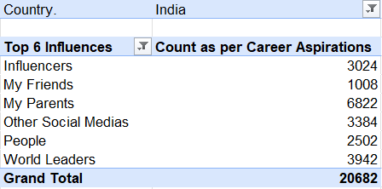

Slide 16
STAGE 5:
ANALYZING IN SQL

Slide 17
What is the gender distribution of respondents from India?
What percentage of respondents from India are interested in education abroad and sponsorship?
What are the 6 top influences on career aspirations for respondents in India?
How do career aspiration influences vary by gender in India?
What percentage of respondents are willing to work for a company for at least 3 years?
How many respondents prefer to work for socially impactful companies?
How does the preference for socially impactful companies vary by gender?
What is the distribution of minimum expected salary in the first three years among respondents?
What is the expected minimum monthly salary in hand?
What percentage of respondents prefer remote working?
What is the preferred number of daily work hours?
What are the common work frustrations among respondents?
How does the need for work-life balance interventions vary by gender?
How many respondents are willing to work under an abusive manager?
What is the distribution of minimum expected salary after five years?
What are the remote working preferences by gender?
What are the top work frustrations for each gender?
What factors boost work happiness and productivity for respondents?
What percentage of respondents need sponsorship for education abroad?

Slide 18
SELECT
Gender,
COUNT(*) AS Respondent_Count
FROM
genzcareeraspirations
WHERE
Country = 'India’
GROUP BY
Gender;
SELECT
HigherEducation AS Response,
COUNT(*) AS Respondent_Count, ROUND((COUNT(*) * 100.0 / (SELECT COUNT(*) FROM genzcareeraspirations WHERE Country = 'India')), 2) AS Percentage
FROM genzcareeraspirations
WHERE Country = 'India’
GROUP BY
HigherEducation;
SELECT
CareerAspirations,
COUNT(*) AS Respondent_Count
FROM genzcareeraspirations
WHERE Country = 'India’
GROUP BY CareerAspirations
ORDER BY Respondent_Count DESC
LIMIT 6;
SELECT
Gender, CareerAspirations,
COUNT(*) AS Respondent_Count
FROM genzcareeraspirations
WHERE Country = 'India’
GROUP BY Gender, CareerAspirations
ORDER BY Gender, Respondent_Count DESC;

Slide 19
SELECT
COUNT(*) AS Willing_Respondents,
ROUND((COUNT(*) * 100.0 / (SELECT COUNT(*) FROM genzcareeraspirations)), 2) AS Percentage
FROM genzcareeraspirations
WHERE LikelihoodofStaying = 'Will work for 3 years or more’;
SELECT
COUNT(*) AS Respondent_Count
FROM genzcareeraspirations
WHERE PreferredWorkSetup = 'Socially Impactful Companies’;
SELECT
Gender,
COUNT(*) AS Respondent_Count
FROM genzcareeraspirations
WHERE PreferredWorkSetup = 'Socially Impactful Companies’
GROUP BY Gender
ORDER BY Respondent_Count DESC;

Slide 20
STAGE 6:
EXECUTIVE DASHBOARD IN EXCEL

Slide 21
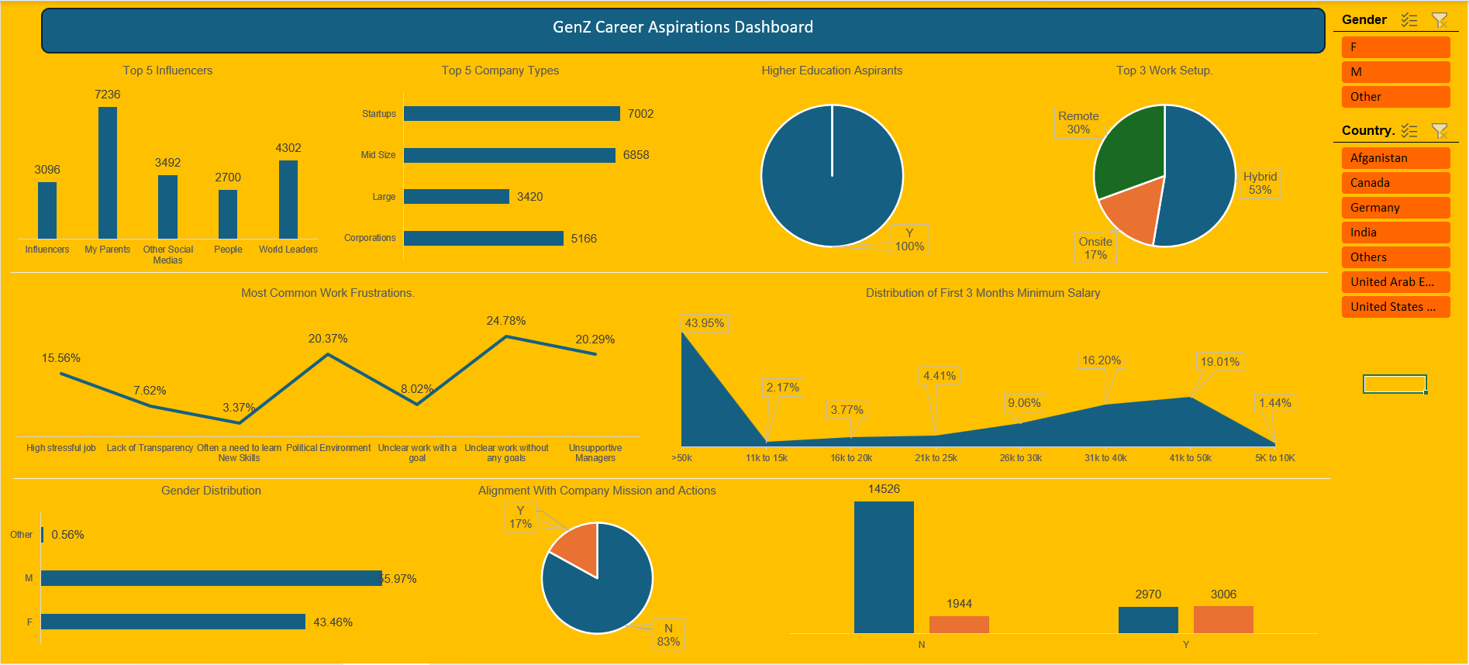

Slide 22
STAGE 7:
FUNCTIONAL DASHBOARD IN POWER BI

Slide 23
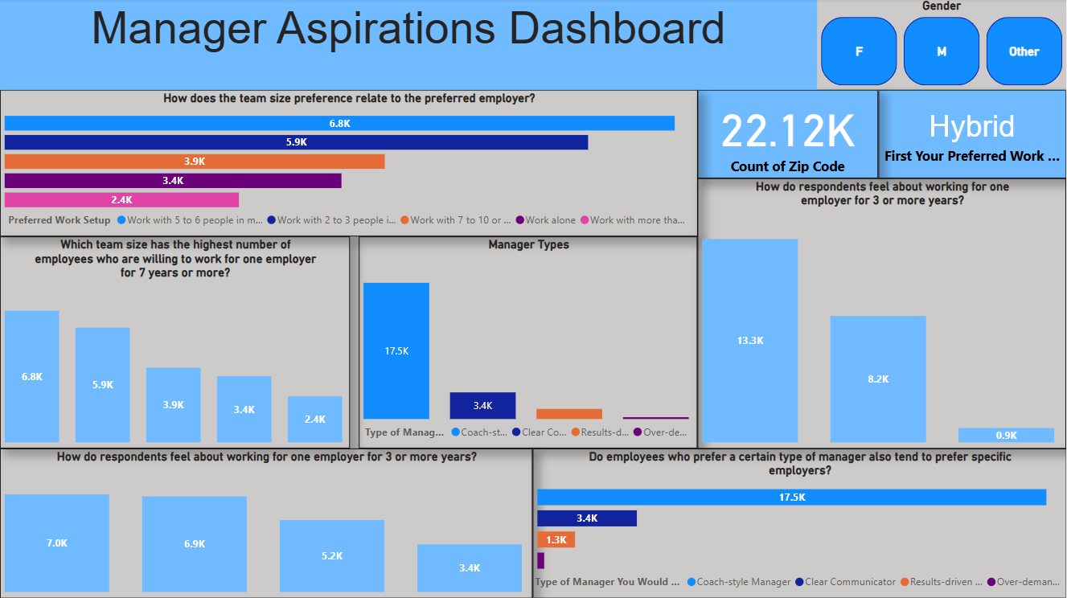

Slide 24
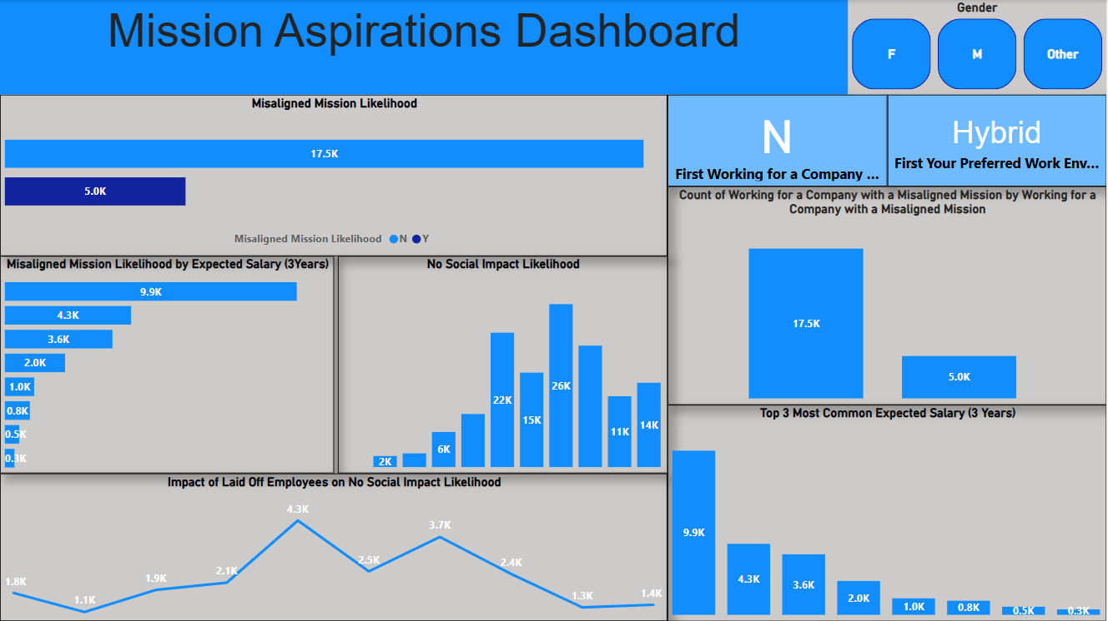

Slide 25


